Slide 1

VDAO - Viable DAO Framework
19 Jun 2020 19:02:27

Slide 2
Purpose
A generalized component structure for modelling DAOs and Self-Regulatory Entities version 0.0.3 June 19th, 2020 author: sam bacha
VDAO - Viable DAO Framework
2
/ 31

Slide 3

Views
Default View
No viewpoint
Elements
Element
Type
Governance Design Constraints
Constraint
VDAO - Viable DAO Framework
3
/ 31

Slide 4

Generated View for Administrator
Implementation and Migration viewpoint
Elements
Element
Type
Administrator
Contract
VDAO - Viable DAO Framework
4
/ 31

Slide 5

Generated View for Contract Objectives
Requirements Realization viewpoint
Elements
Element
Type
Contract Objectives
Contract
VDAO - Viable DAO Framework
5
/ 31

Slide 6
Generated View for Contract Objectives
Outcome Realization viewpoint
Elements
Element
Type
Contract Objectives
Contract
VDAO - Viable DAO Framework
6
/ 31

Slide 7
Generated View for Contract Objectives
Implementation and Migration viewpoint
Elements
Element
Type
Contract Objectives
Contract
VDAO - Viable DAO Framework
7
/ 31

Slide 8

Generated View for Contract Objectives
Requirements Realization viewpoint
Elements
Element
Type
Contract Objectives
Contract
Legal Object
Business Object
VDAO - Viable DAO Framework
8
/ 31

Slide 9

Generated View for Contract Objectives
Product viewpoint
Elements
Element
Type
Contract Objectives
Contract
Legal Object
Business Object
VDAO - Viable DAO Framework
9
/ 31

Slide 10
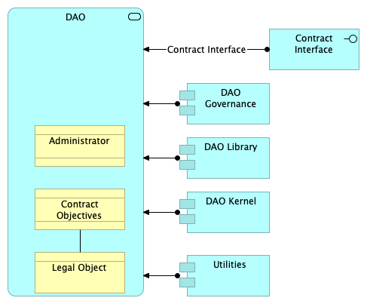
Generated View for DAO
Implementation and Migration viewpoint
Elements
Element
Type
Administrator
Contract
Contract Interface
Application Interface
Contract Objectives
Contract
DAO
Application Service
DAO Governance
Application Component
DAO Kernel
Application Component
DAO Library
Application Component
Legal Object
Business Object
Utilities
Application Component
VDAO - Viable DAO Framework
10
/ 31

Slide 11
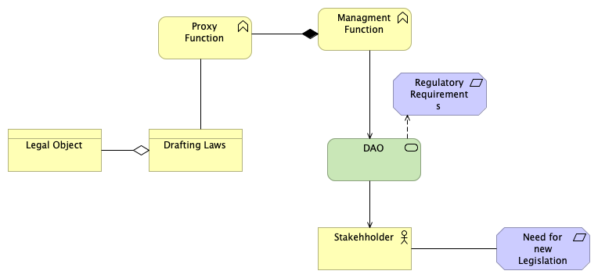
Generated View for Drafting Laws
Implementation and Migration viewpoint
Elements
Element
Type
DAO
Technology Service
Drafting Laws
Business Object
Legal Object
Business Object
Managment Function
Business Function
Need for new Legislation
Requirement
Proxy Function
Business Function
Regulatory Requirements
Requirement
Stakehholder
Business Actor
VDAO - Viable DAO Framework
11
/ 31

Slide 12
Generated View for Governance Design Constraints
Implementation and Migration viewpoint
Elements
Element
Type
Governance Design Constraints
Constraint
VDAO - Viable DAO Framework
12
/ 31

Slide 13
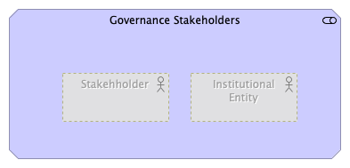
Generated View for Governance Stakeholders
Stakeholder viewpoint
Elements
Element
Type
Governance Stakeholders
Stakeholder
Institutional Entity
Business Actor
Stakehholder
Business Actor
VDAO - Viable DAO Framework
13
/ 31

Slide 14
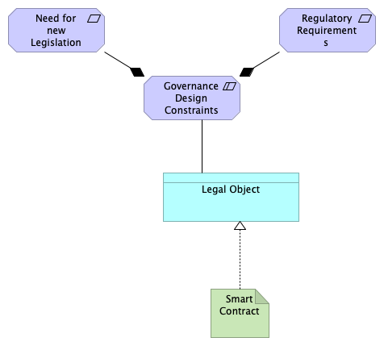
Generated View for Legal Object
Implementation and Migration viewpoint
Elements
Element
Type
Governance Design Constraints
Constraint
Legal Object
Data Object
Need for new Legislation
Requirement
Regulatory Requirements
Requirement
Smart Contract
Artifact
VDAO - Viable DAO Framework
14
/ 31

Slide 15
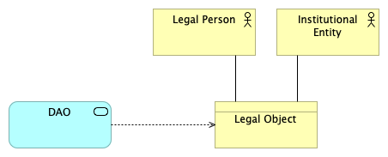
Generated View for Legal Object
Application Usage viewpoint
Elements
Element
Type
DAO
Application Service
Institutional Entity
Business Actor
Legal Object
Business Object
Legal Person
Business Actor
VDAO - Viable DAO Framework
15
/ 31

Slide 16
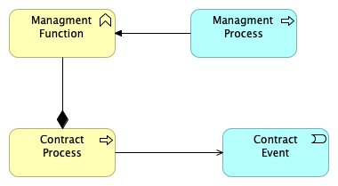
Generated View for Managment Function
Application Usage viewpoint
Elements
Element
Type
Contract Event
Application Event
Contract Process
Business Process
Managment Function
Business Function
Managment Process
Application Process
VDAO - Viable DAO Framework
16
/ 31

Slide 17

Generated View for Need for new Legislation
Implementation and Migration viewpoint
Elements
Element
Type
Need for new Legislation
Requirement
VDAO - Viable DAO Framework
17
/ 31

Slide 18

Generated View for Proxy Function
Application Usage viewpoint
Elements
Element
Type
Managment Function
Business Function
Proxy Function
Business Function
VDAO - Viable DAO Framework
18
/ 31

Slide 19

Generated View for Regulatory Requirements
Implementation and Migration viewpoint
Elements
Element
Type
Regulatory Requirements
Requirement
VDAO - Viable DAO Framework
19
/ 31

Slide 20
Map View
No viewpoint
VDAO - Viable DAO Framework
20
/ 31

Slide 21
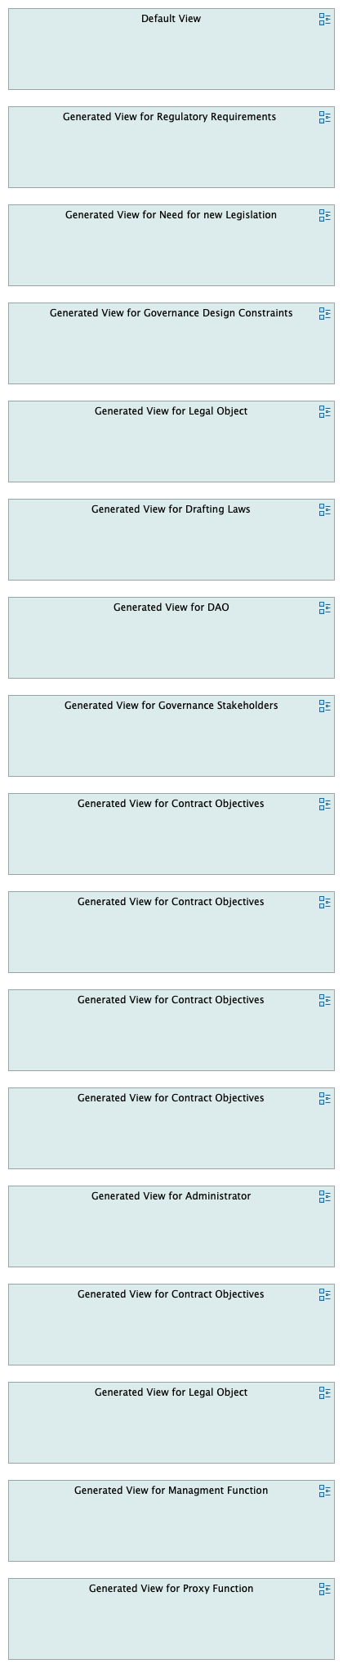
VDAO - Viable DAO Framework
21
/ 31

Slide 22
VDAO - Viable DAO Framework
22
/ 31

Slide 23
Business Layer
Administrator
Type
Contract
Admin Key
Contract Objectives
Type
Contract
Contract Process
Type
Business Process
Drafting Laws
Type
Business Object
Governance as a Service
Type
Business Service
Governance Stakeholders
Type
Business Interaction
Institutional Entity
Type
Business Actor
This is the entity that the DAO controls
Legal Object
Type
Business Object
Legal Person
Type
Business Actor
Managment Function
Type
Business Function
Protocol
Type
Product
protocol
contract
contract
event
A generalized objective, for example to manage assets under the contracts control or to implement some discrete process
VDAO - Viable DAO Framework
23
/ 31

Slide 24
Proxy Function
Type
Business Function
Stakehholder
Type
Business Actor
VDAO - Viable DAO Framework
24
/ 31

Slide 25
Application Layer
Contract Event
Type
Application Event
Contract Interface
Type
Application Interface
DAO
Type
Application Service
DAO Governance
Type
Application Component
DAO Kernel
Type
Application Component
This is the core logic implemtation for the smart contract
DAO Library
Type
Application Component
Legal Object
Type
Data Object
Managment Process
Type
Application Process
Utilities
Type
Application Component
VDAO - Viable DAO Framework
25
/ 31

Slide 26
Technology & Physical Layer
DAO
Type
Technology Service
DAO Interaction
Type
Technology Interaction
Smart Contract
Type
Artifact
VDAO - Viable DAO Framework
26
/ 31

Slide 27
Motivation
Goal
Type
Goal
Governance Design Constraints
Type
Constraint
legal
schema
Governance Stakeholders
Type
Stakeholder
As of this model, it only represents the direct stake holders. 3rd parties to governance which may have a stake in such governance are not reperesented in this diagram.
Need for new Legislation
Type
Requirement
Regulatory Requirements
Type
Requirement
VDAO - Viable DAO Framework
27
/ 31

Slide 28
Relations
Assignment relation
Type
Assignment relation
Source
Utilities
Target
DAO
Assignment relation
Type
Assignment relation
Source
DAO Kernel
Target
DAO
Assignment relation
Type
Assignment relation
Source
DAO Library
Target
DAO
Assignment relation
Type
Assignment relation
Source
DAO Governance
Target
DAO
Assignment relation
Type
Assignment relation
Source
Stakehholder
Target
Governance Stakeholders
Serving relation
Type
Serving relation
Source
Contract Interface
Target
DAO
Realization relation
Type
Realization relation
Source
Smart Contract
Target
Legal Object
Realization relation
Type
Realization relation
Source
Legal Object
Target
Goal
Realization relation
Type
Realization relation
VDAO - Viable DAO Framework
28
/ 31

Slide 29
Source
Legal Object
Target
Governance Design Constraints
Composition relation
Type
Composition relation
Source
Governance Design Constraints
Target
Regulatory Requirements
Composition relation
Type
Composition relation
Source
Governance Design Constraints
Target
Need for new Legislation
Association relation
Type
Association relation
Source
Governance Design Constraints
Target
Legal Object
Association relation
Type
Association relation
Source
Contract Objectives
Target
Legal Object
Association relation
Type
Association relation
Source
Legal Person
Target
Legal Object
Association relation
Type
Association relation
Source
Institutional Entity
Target
Legal Object
Access relation
Type
Access relation
Source
DAO
Target
Legal Object
Realization relation
Type
Realization relation
Source
Smart Contract
Target
Legal Object
VDAO - Viable DAO Framework
29
/ 31

Slide 30
Access relation
Type
Access relation
Source
DAO
Target
Administrator
Access relation
Type
Access relation
Source
DAO
Target
Contract Objectives
Triggering relation
Type
Triggering relation
Source
Managment Process
Target
Managment Function
Composition relation
Type
Composition relation
Source
Contract Process
Target
Managment Function
Serving relation
Type
Serving relation
Source
Contract Process
Target
Contract Event
Composition relation
Type
Composition relation
Source
Managment Function
Target
Proxy Function
Association relation
Type
Association relation
Source
Drafting Laws
Target
Proxy Function
Triggering relation
Type
Triggering relation
Source
Stakehholder
Target
Managment Function
Aggregation relation
Type
Aggregation relation
Source
Drafting Laws
Target
Legal Object
VDAO - Viable DAO Framework
30
/ 31

Slide 31
Serving relation
Type
Serving relation
Source
DAO
Target
Stakehholder
Influence relation
Type
Influence relation
Source
DAO
Target
Regulatory Requirements
Realization relation
Type
Realization relation
Source
DAO
Target
Need for new Legislation
Serving relation
Type
Serving relation
Source
Managment Function
Target
DAO
Association relation
Type
Association relation
Source
Need for new Legislation
Target
Stakehholder
Contract Interface
Type
Assignment relation
Source
Contract Interface
Target
DAO
A Smart Contract Interface
VDAO - Viable DAO Framework
31
/ 31

